Slide 1
JOOPIUM.COM
Earn money from local restaurants
£5 Million worth of Online Sales in 2022
100s of Happy Restaurants
Official Partner of Reserve with Google
We want to recruit 1000 Resellers for our SaaS platform
Amal Vijay 07446152123

Slide 2
Problem: Accelerated Digitalisation is happening in the Restaurant Industry.
Restaurant owners are struggling to look after their Technology, Branding and Digital Profiles.
HOW MANY SERVICE PROVIDERS DO A RESTAURANT NEED?
Social Media Manager !!
Booking Systems!!
Web Developer !!
App Developer !!
Payment gateways !!
Takeaway portals !!

Slide 3
Just one! Anyone can build Cloud Restaurants using JOOPIUM™ and make £1000s monthly. Its proven!

Slide 4
Success Story
Surendra, previously Uber driver joins as our Reseller
Manages about 25 restaurants in Blackpool and Manchester area
Earns an average of £2000 monthly from our Cloud restaurants
Found it easy to recruit restaurants as if restaurants owners were in serious pain
As a Reseller, Surendra spends hardly few hours weekly helping restaurants with Branding, Marketing and Technical Support. In return he earns a part of the commission which is more than £2000 pcm for the last 18 months
JOOPIUM democratises Restaurant Technology and Branding Industry

Slide 5
Our Cloud Restaurant features
Takeaway: Restaurant’s own website that helps customers order takeaway for delivery or collection.
Booking: Restaurant’s own booking platform with Email and Text message confirmations. Single button click operation saves many working hours.
Vouchers: Restaurant’s own voucher system to attract customers to dine in. A must have feature for the post Covid market.
Dine in: A QR code based Dine in order system where customers order food directly without the help of a waiter.
Delivery: Delivery service through Resellers is coming soon.

Slide 6
Technology
We generate ‘Complete’ Data related to Takeaway, Dine in and Booking of a restaurant
Our JOOPER AI Program (under construction) will control and enhance User experience for both Dine in and Takeaway customers using this Data
Automated generation of Cloud Restaurants
SaaS Cloud

Slide 7
Business Model
Resellers build Cloud Restaurant on our SaaS platform. Means restaurants join for FREE
We charge up to 15% on all Transactions and £2 per head on all Bookings. In future, with delivery service, we will charge upto 25%
We share revenue with our Resellers that is visible on their Dashboard

Slide 8
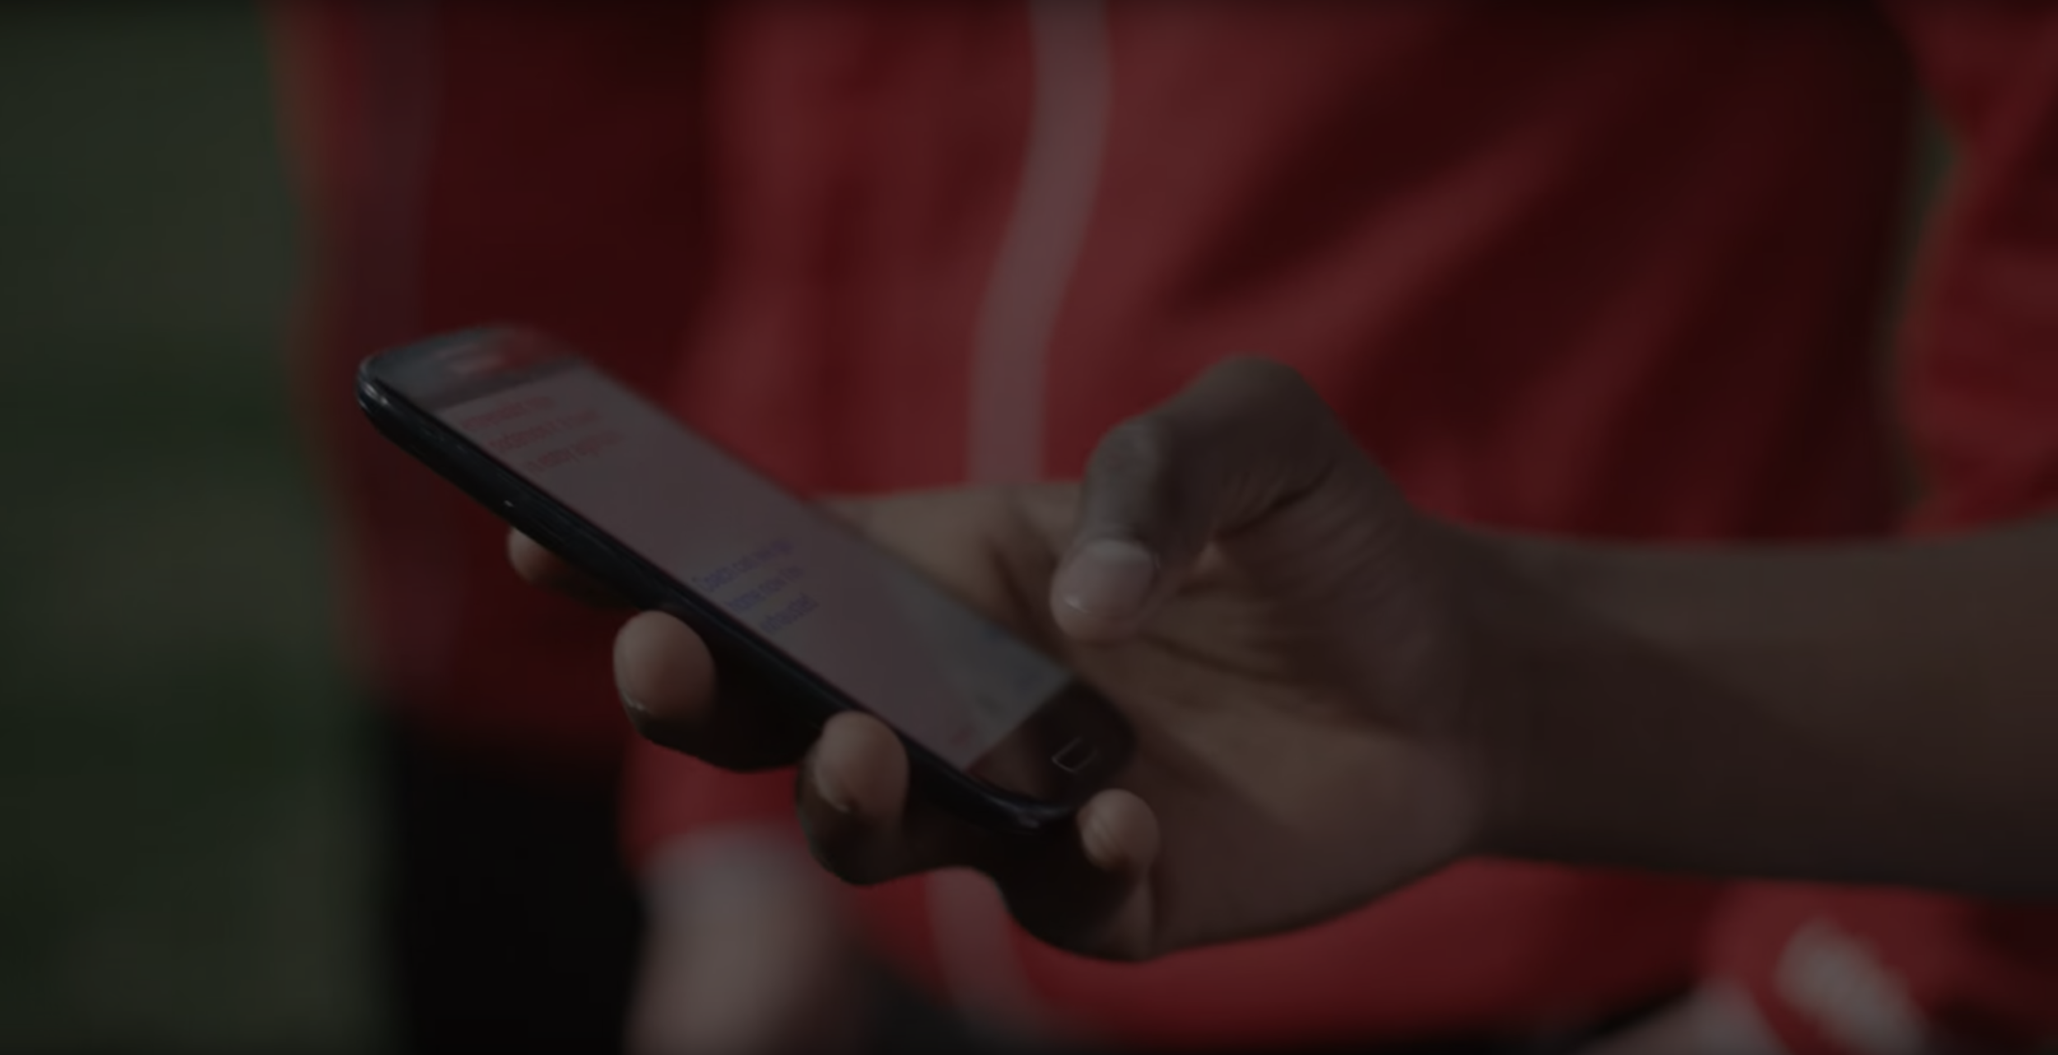
More than 200 Restaurants use our Solutions
Live operations in Foreign Countries. Highly Scalable!
Viral Engine of Growth through Resellers and it has been proven
Orders worth more than £5 Million in the last 12 months

Slide 9
Competition
No one focuses on Total Business of a restaurant which includes Dine in, Takeaway and Marketing. Portals such as Deliveroo, Just Eat and Ubereats are just takeaway solutions while Open Table and Quandoo are just Booking platforms.
Our commission based business model brings more money compared to other subscription based plans such as flipdish. Also we have onsite support of resellers that no competitor can match!
No one has a viral engine of growth model such as our reseller plan.
We are in the Blue Ocean with unique value proposition and Competition is irrelevant.

Slide 10
Team
CEO: Amal Vijay MS, BEng
CTO: Abhilash Raj BEng
CFO: Mathew Stephen CA,FCA,CeFA

Slide 11
Milestones
2020
October 2015
August 2019
January 2022
2021
£2M in Online Transactions
£130K in Commision
£5M in Online Transactions
£170K in Commision
Free web builder
2018 |  |  |  | 2020 2022
Commission based system
Reseller approach
JOOPIUM as a platform
Aiming for £100m transactional volume/year and Expansion in India

Slide 12
Projections
Currently 10 Resellers with 100 Restaurants generate £2 Million in Gross Sales Volume and £165k in Commission.
With £2M investment, the company is confident that it will grow the number of restaurant partners to 5000 restaurants and can generate annual profit of more than £6m.

Slide 13
What’s next?
1.Recruit resellers in the EU to expand
2.Deploy direct marketing executives in India to expand in India
3.Offer Delivery service through resellers and charge 25% Commission
4.Develop JOOPER AI application that will enhance user experience
Investment seeking £2m
CEO Amal Vijay
07446152123

